Slide 1

Kashi Report — …
20-08-2026

Slide 2

20-08-2026
3 Party Pages Posting | 5
Hyper Local Pages Posting | 13
National X Influencers | 4
Counter Comments Links | 26
Total Items Tracked | 48

Slide 3


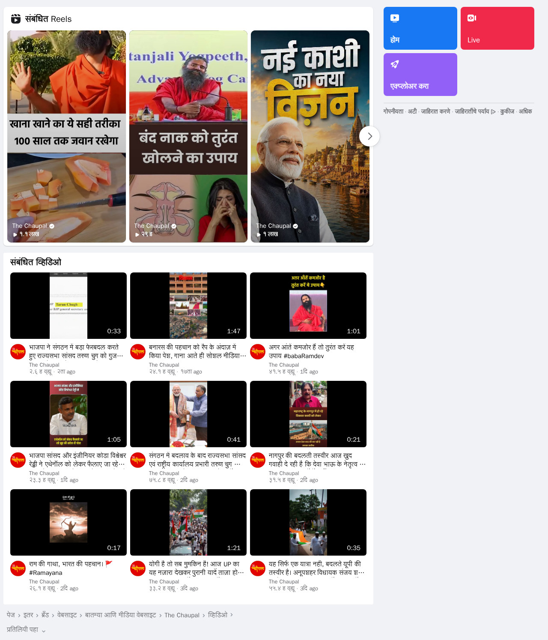
Top 5 Posts
Post 1
The Chaupal
20-08-2026
5 Posts
LINK

Slide 4
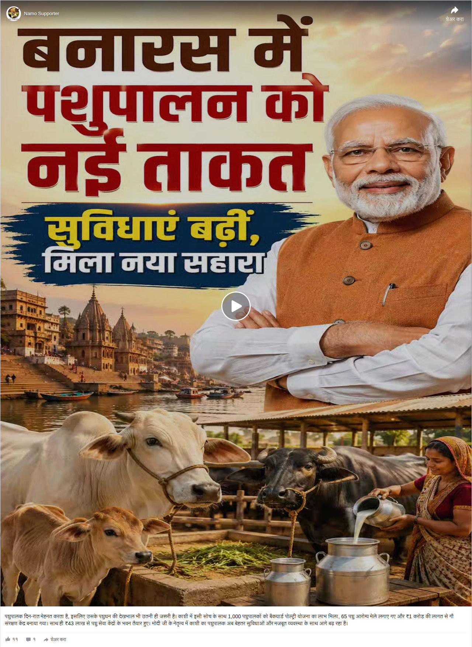
Top 5 Posts
Post 2
Namo Supporter
20-08-2026
5 Posts
LINK

Slide 5
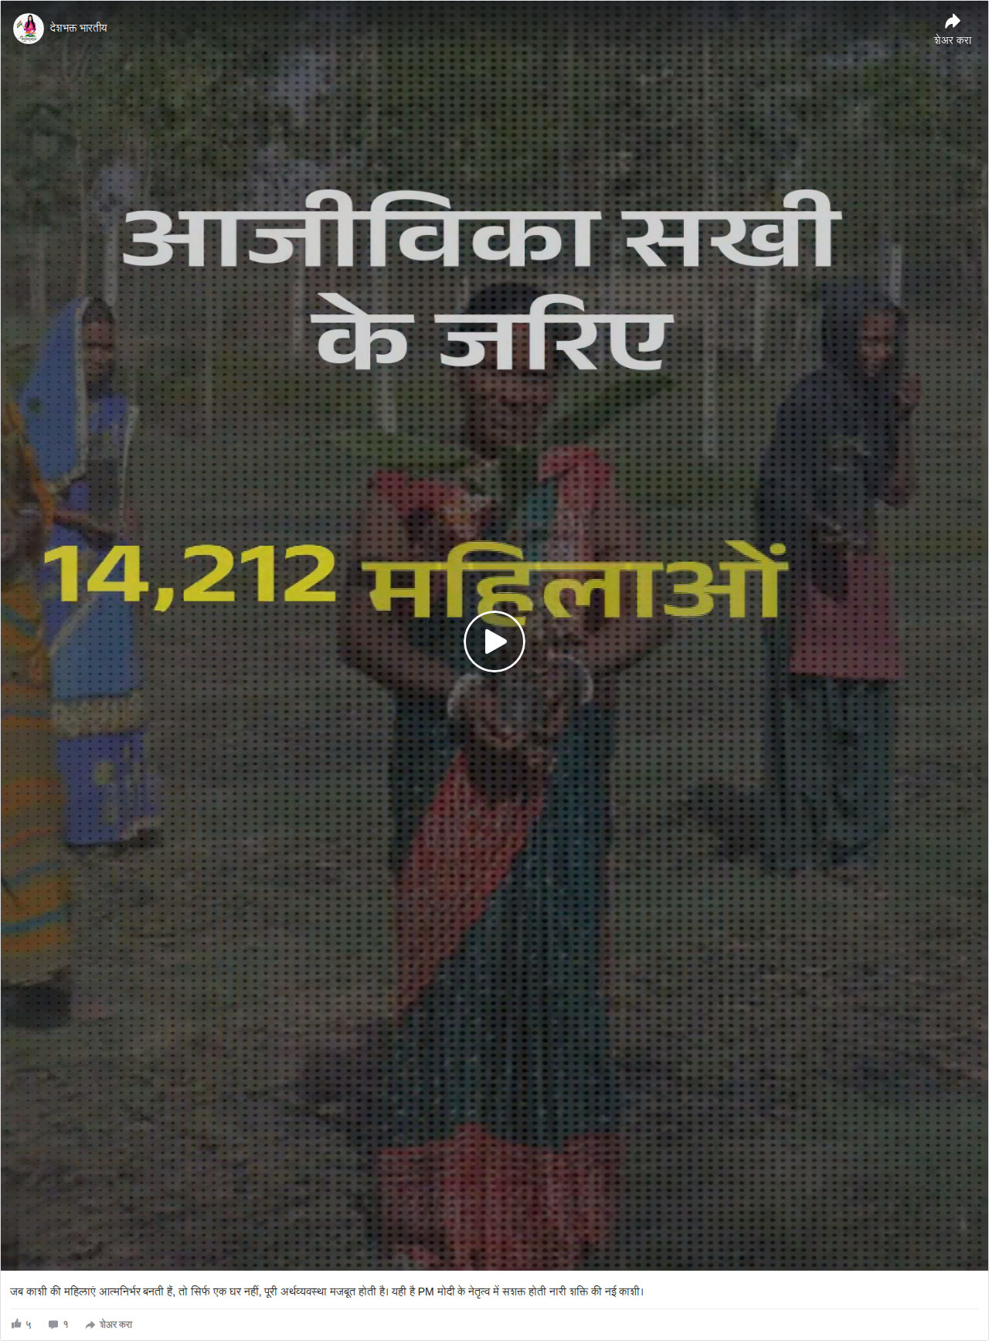
Top 5 Posts
Post 3
देशभक्त भारतीय
20-08-2026
5 Posts
LINK

Slide 6

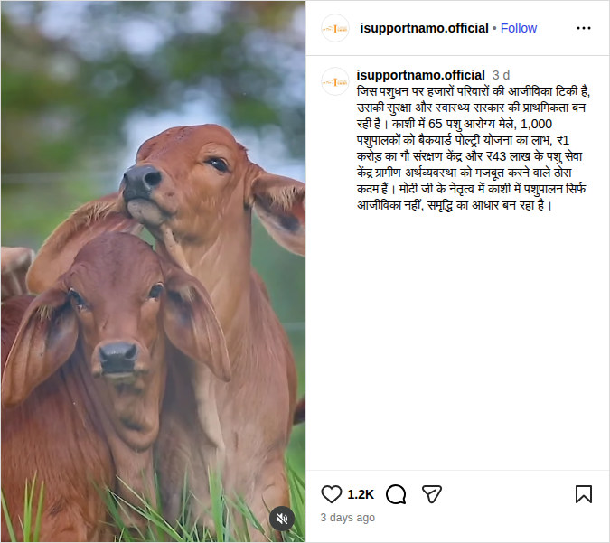
Top 5 Posts
Post 4
@isupportnamo.official
20-08-2026
5 Posts
LINK

Slide 7
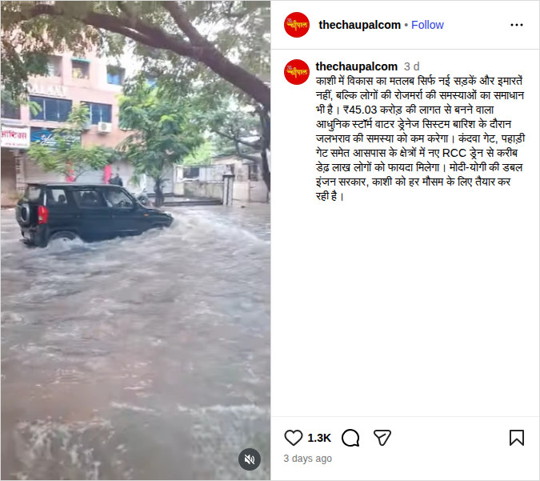
Top 5 Posts
Post 5
@thechaupalcom
20-08-2026
5 Posts
LINK

Slide 8
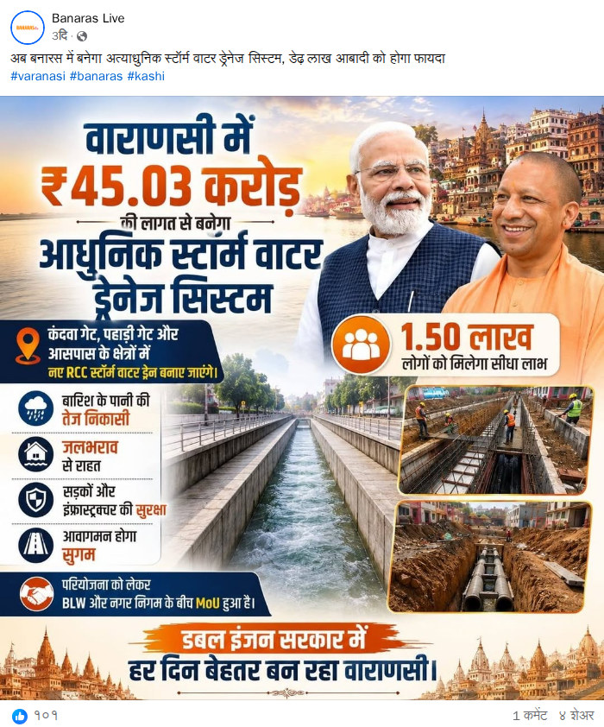
Top 13 Posts
Post 1
Banaras Live
20-08-2026
13 Posts
LINK

Slide 9

Top 13 Posts
Post 2
काशी के मोदी
20-08-2026
13 Posts
LINK

Slide 10
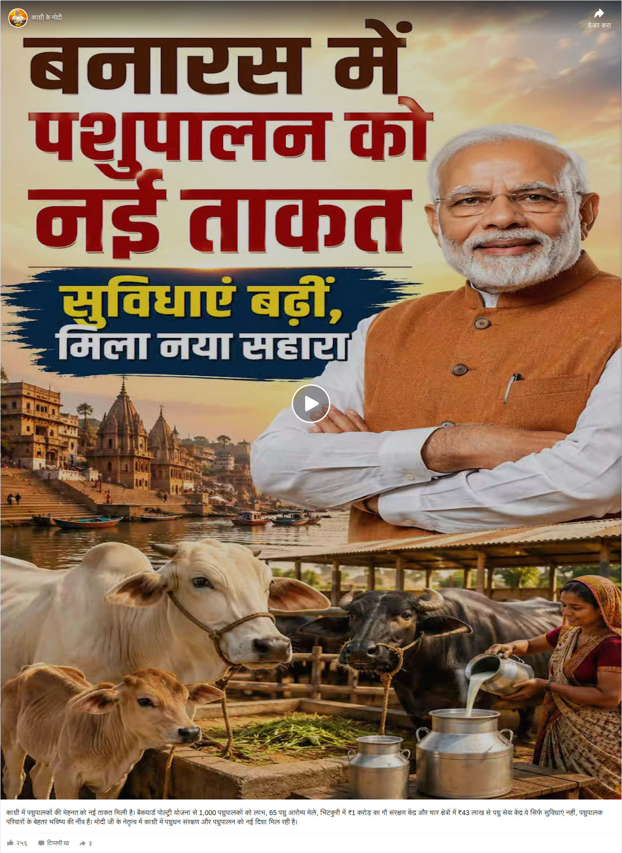
Top 13 Posts
Post 3
काशी के मोदी
20-08-2026
13 Posts
LINK

Slide 11
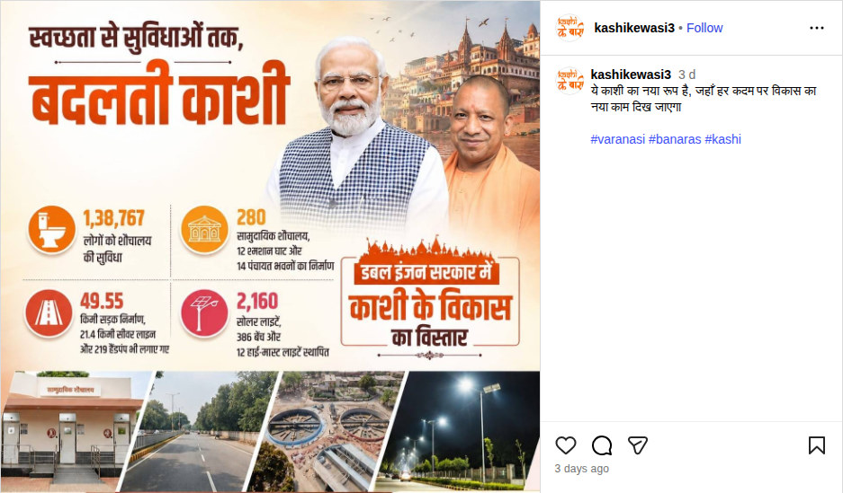
Top 13 Posts
Post 4
@kashikewasi3
20-08-2026
13 Posts
LINK

Slide 12
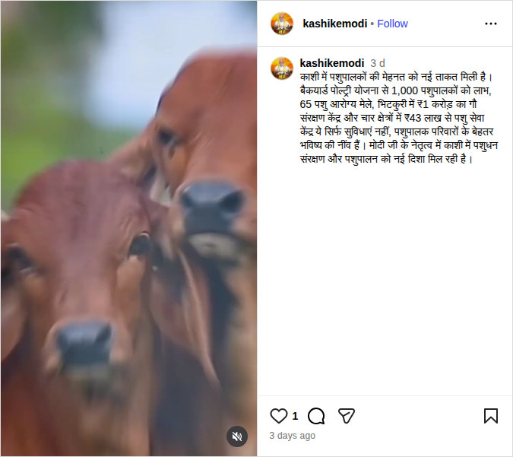
Top 13 Posts
Post 5
@kashikemodi
20-08-2026
13 Posts
LINK

Slide 13
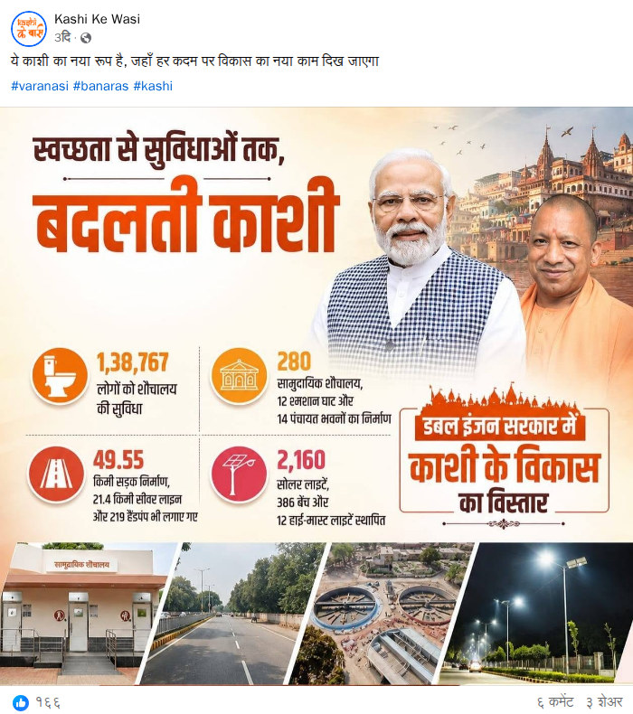
Top 13 Posts
Post 6
Kashi Ke Wasi
20-08-2026
13 Posts
LINK

Slide 14
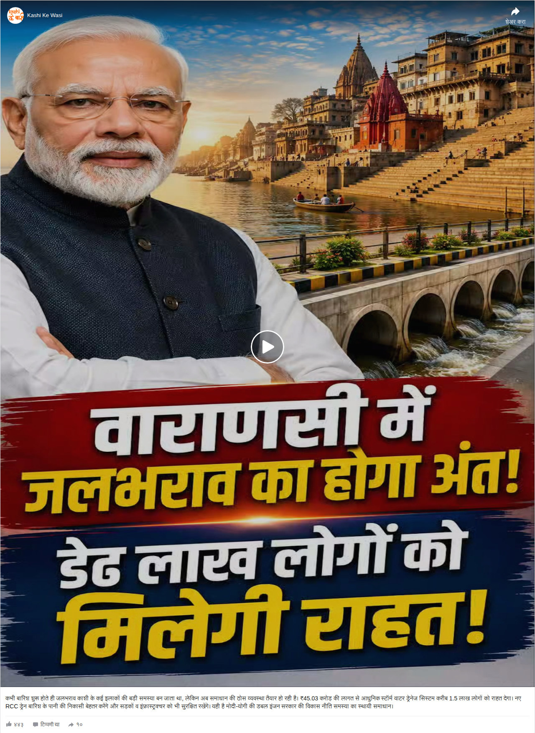
Top 13 Posts
Post 7
Kashi Ke Wasi
20-08-2026
13 Posts
LINK

Slide 15

Top 13 Posts
Post 8
Kashi Ke Wasi
20-08-2026
13 Posts
LINK

Slide 16
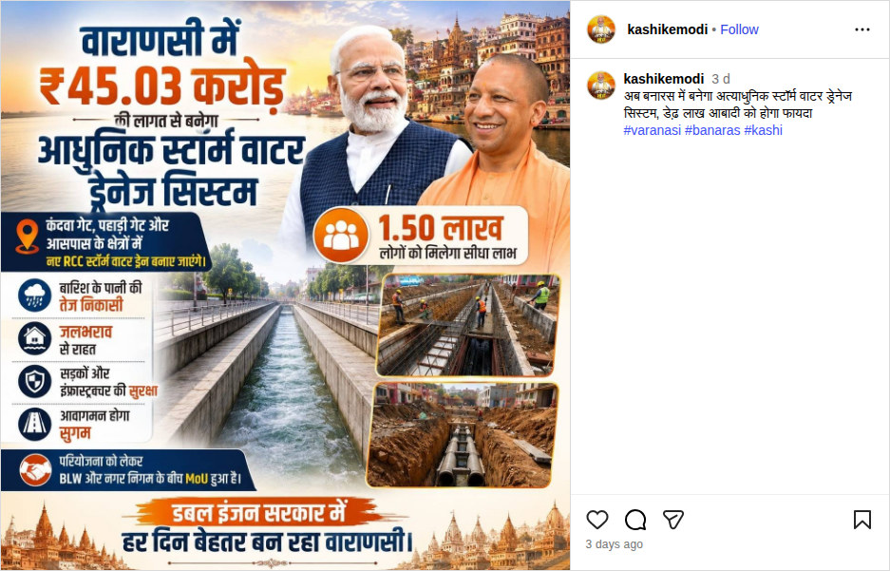
Top 13 Posts
Post 9
@kashikemodi
20-08-2026
13 Posts
LINK

Slide 17
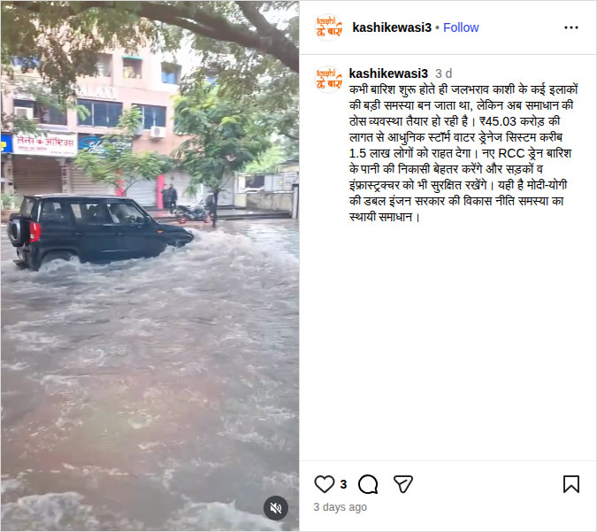
Top 13 Posts
Post 10
@kashikewasi3
20-08-2026
13 Posts
LINK

Slide 18
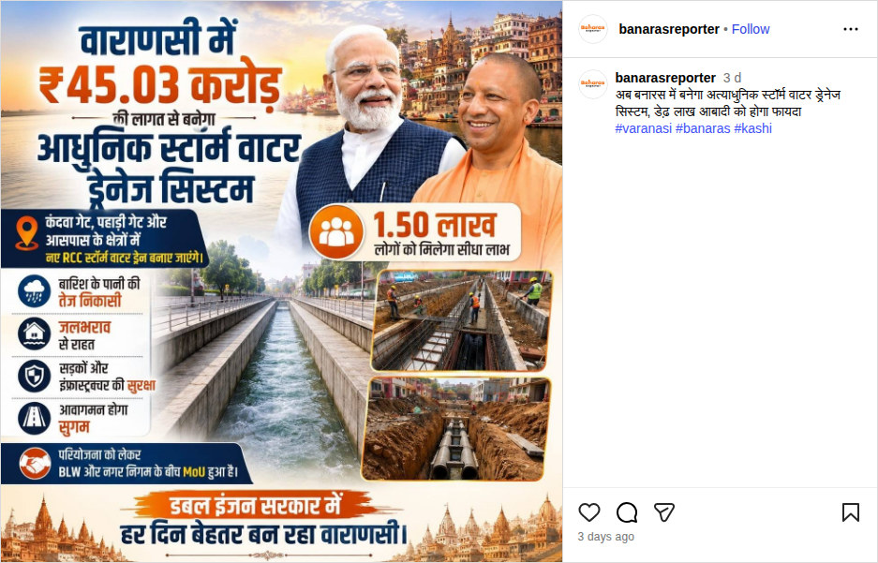
Top 13 Posts
Post 11
@banarasreporter
20-08-2026
13 Posts
LINK

Slide 19
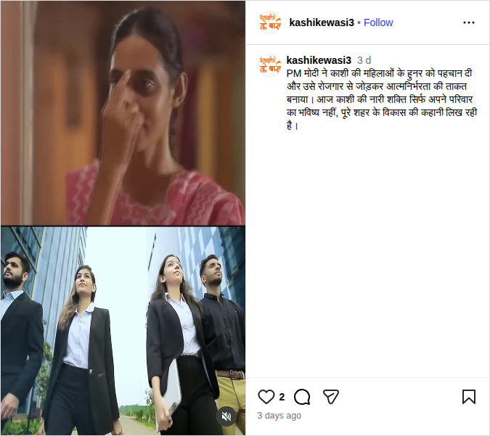
Top 13 Posts
Post 12
@kashikewasi3
20-08-2026
13 Posts
LINK

Slide 20

Top 13 Posts
Post 13
Banaras Reporter
20-08-2026
13 Posts
LINK

Slide 21

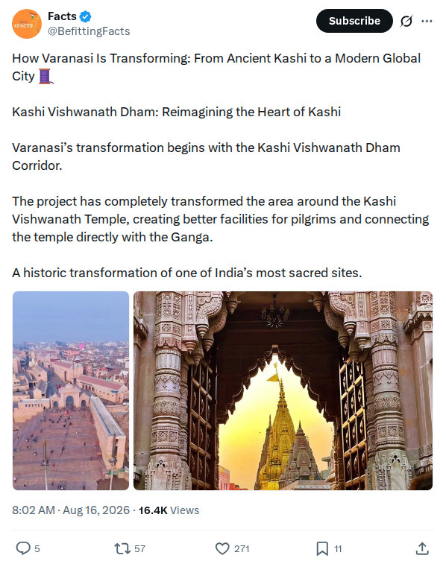
Top 4 Posts
Post 1
@BefittingFacts
20-08-2026
4 Posts
LINK

Slide 22
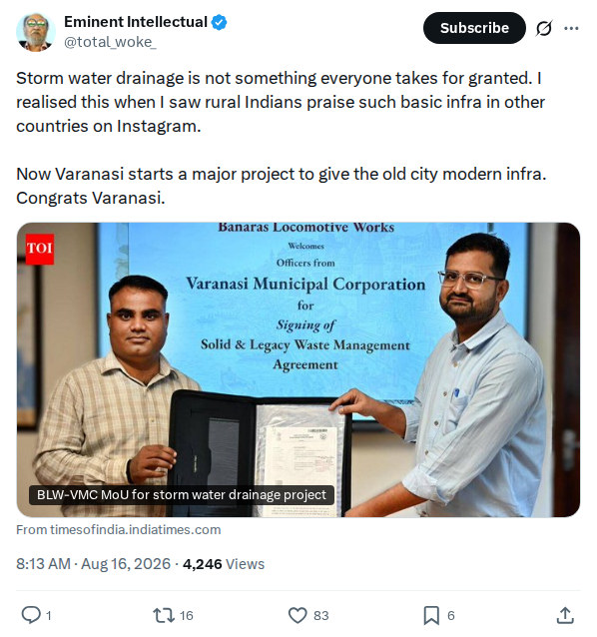
Top 4 Posts
Post 2
@total_woke_
20-08-2026
4 Posts
LINK

Slide 23
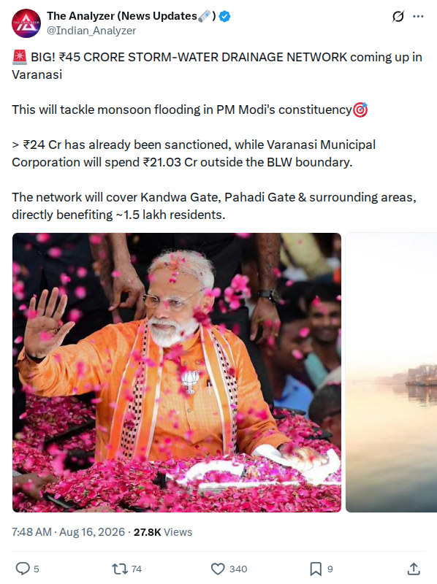
Top 4 Posts
Post 3
@Indian_Analyzer
20-08-2026
4 Posts
LINK

Slide 24
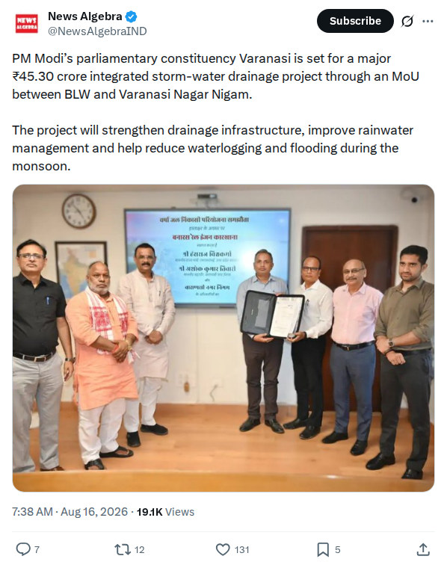
Top 4 Posts
Post 4
@NewsAlgebraIND
20-08-2026
4 Posts
LINK

Slide 25
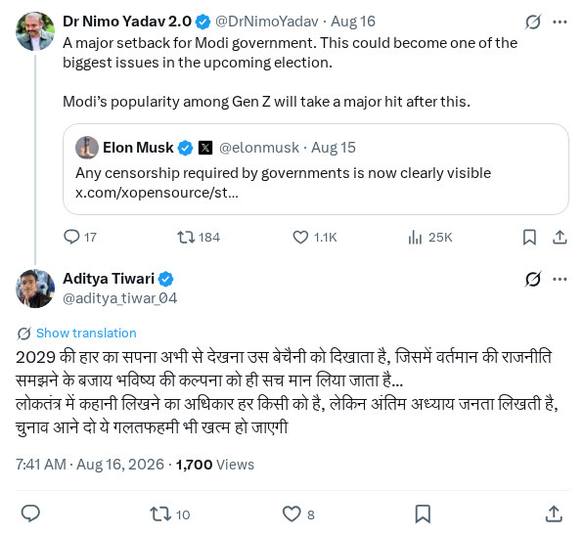
Top 26 Posts
Post 1
@aditya_tiwar_04
20-08-2026
26 Posts
LINK

Slide 26
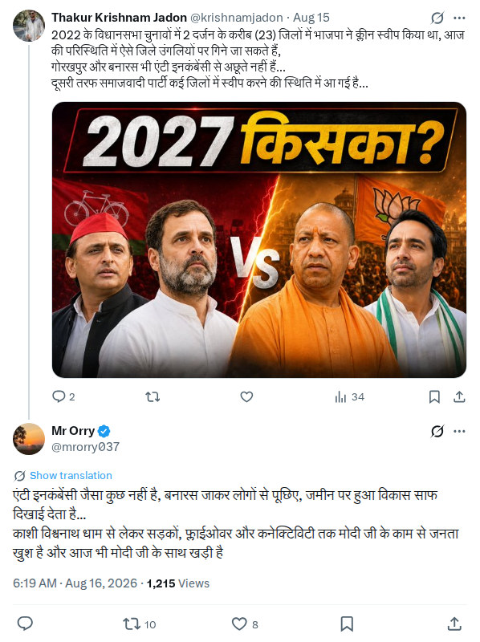
Top 26 Posts
Post 2
@mrorry037
20-08-2026
26 Posts
LINK

Slide 27

Top 26 Posts
Post 3
@PoonammJi
20-08-2026
26 Posts
LINK

Slide 28
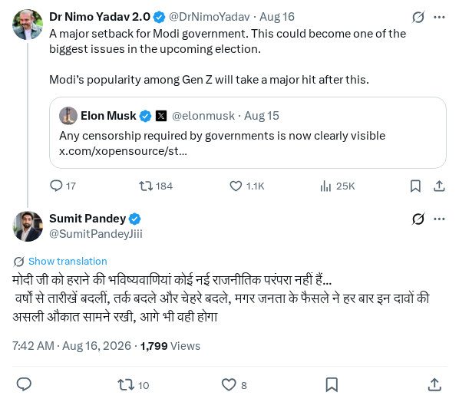
Top 26 Posts
Post 4
@SumitPandeyJiii
20-08-2026
26 Posts
LINK

Slide 29
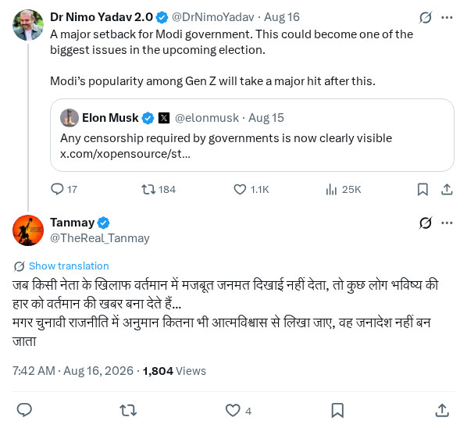
Top 26 Posts
Post 5
@TheReal_Tanmay
20-08-2026
26 Posts
LINK

Slide 30
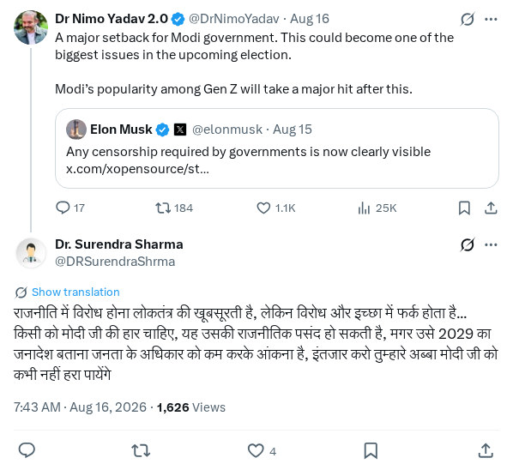
Top 26 Posts
Post 6
@DRSurendraShrma
20-08-2026
26 Posts
LINK

Slide 31
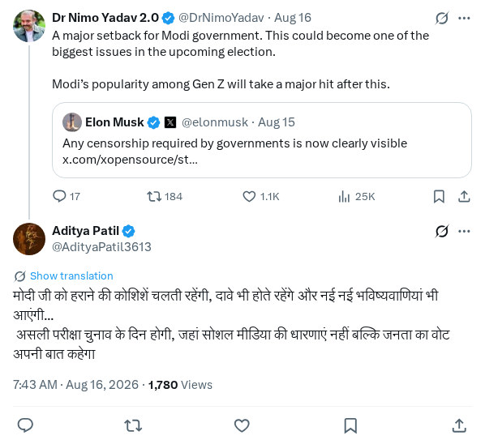
Top 26 Posts
Post 7
@AdityaPatil3613
20-08-2026
26 Posts
LINK

Slide 32
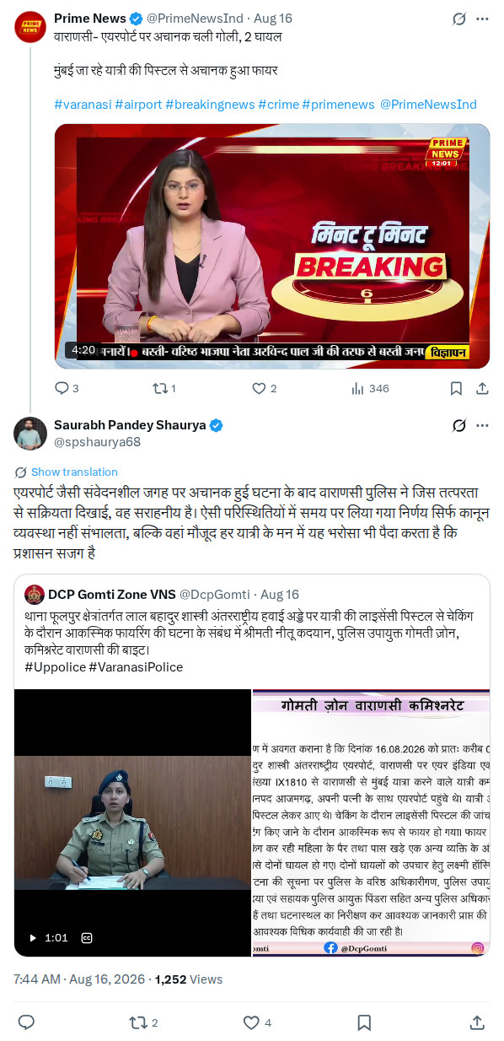
Top 26 Posts
Post 8
@spshaurya68
20-08-2026
26 Posts
LINK

Slide 33
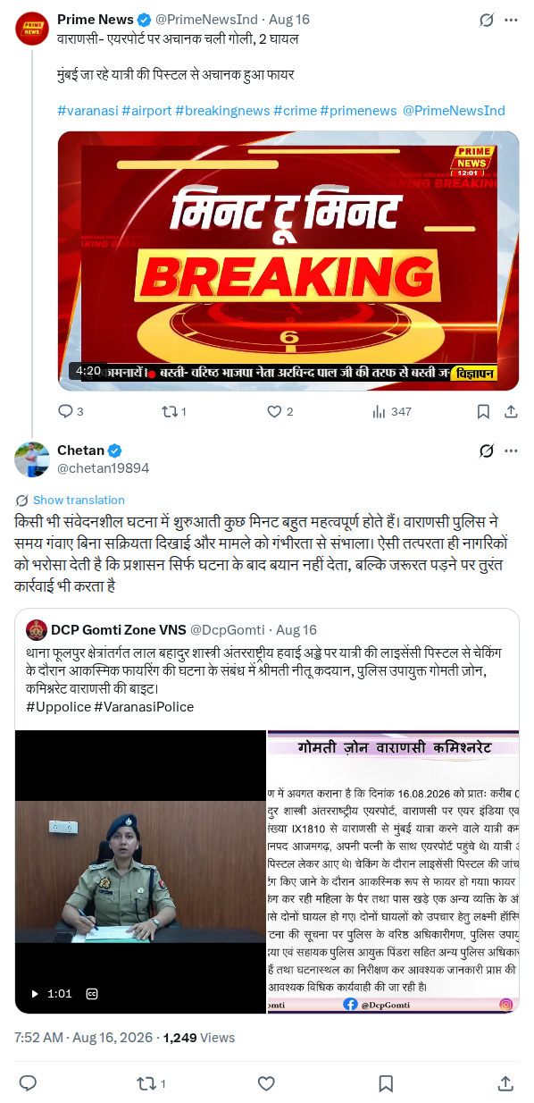
Top 26 Posts
Post 9
@chetan19894
20-08-2026
26 Posts
LINK

Slide 34
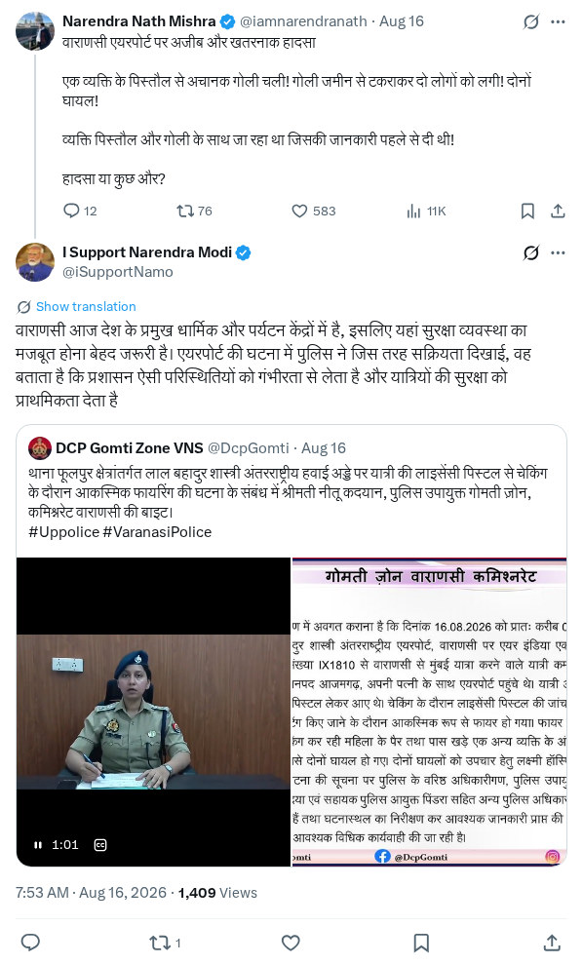
Top 26 Posts
Post 10
@iSupportNamo
20-08-2026
26 Posts
LINK

Slide 35
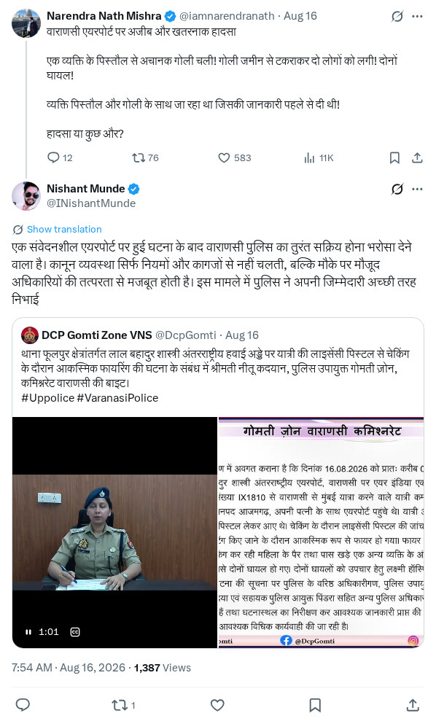
Top 26 Posts
Post 11
@INishantMunde
20-08-2026
26 Posts
LINK

Slide 36
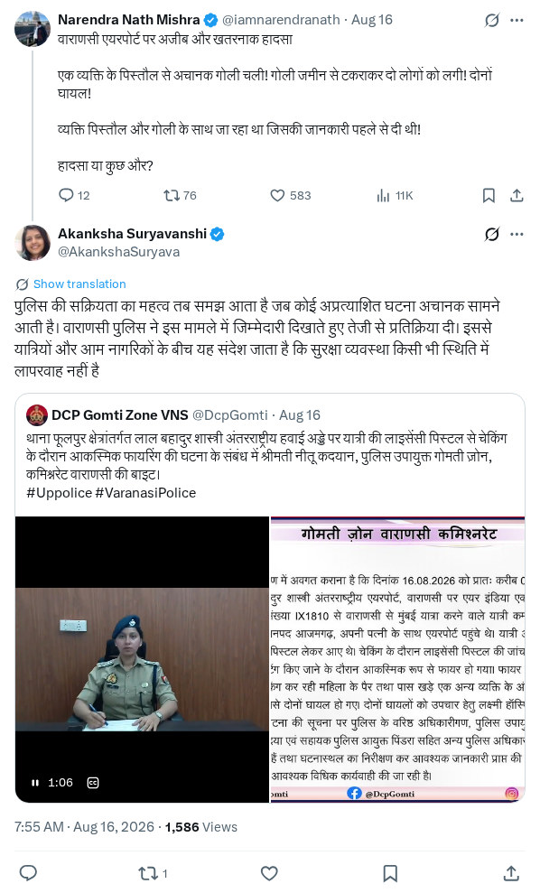
Top 26 Posts
Post 12
@AkankshaSuryava
20-08-2026
26 Posts
LINK

Slide 37
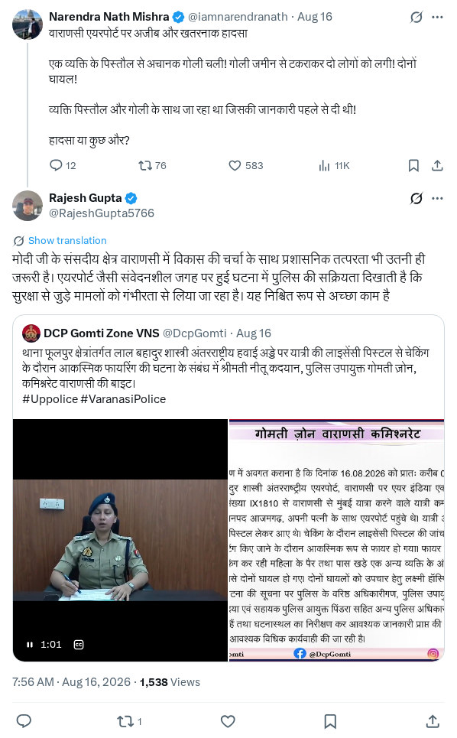
Top 26 Posts
Post 13
@RajeshGupta5766
20-08-2026
26 Posts
LINK

Slide 38
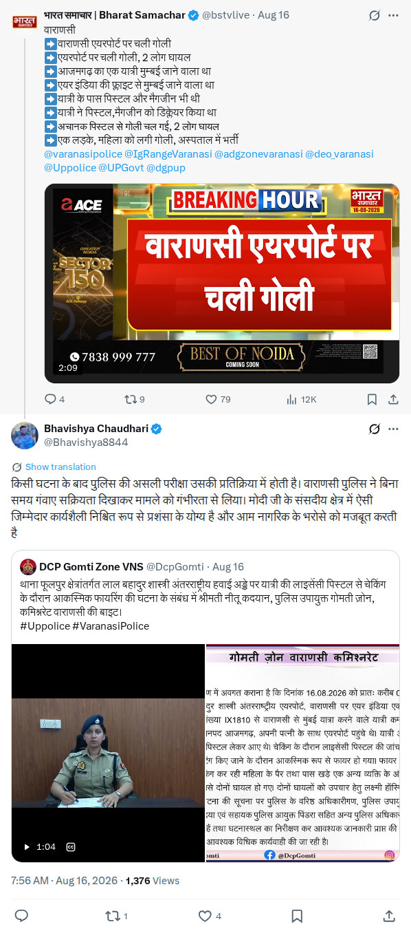
Top 26 Posts
Post 14
@Bhavishya8844
20-08-2026
26 Posts
LINK

Slide 39
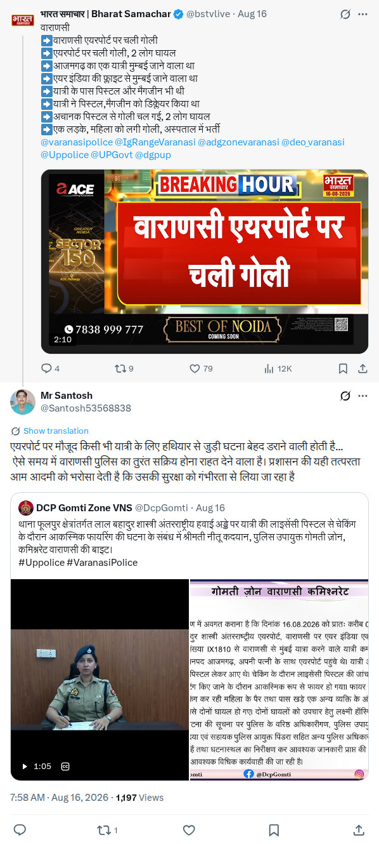
Top 26 Posts
Post 15
@Santosh53568838
20-08-2026
26 Posts
LINK

Slide 40
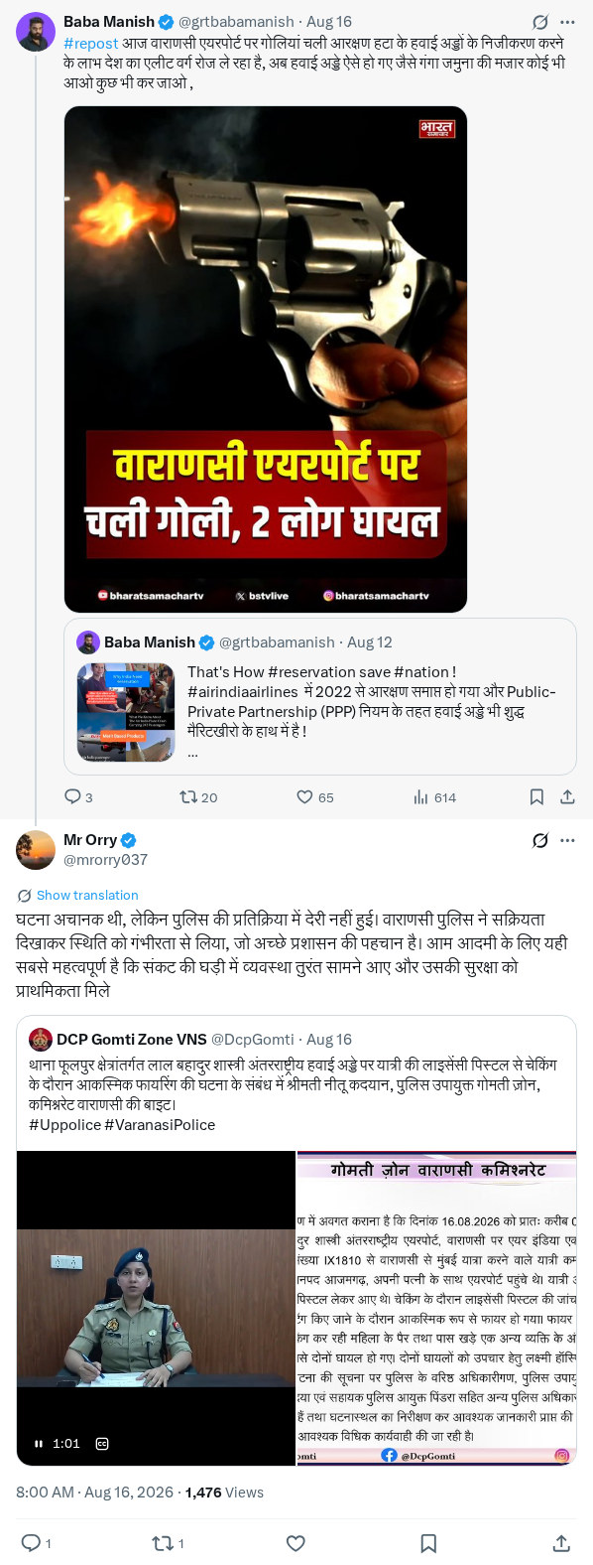
Top 26 Posts
Post 16
@mrorry037
20-08-2026
26 Posts
LINK

Slide 41

Top 26 Posts
Post 17
@PoonammJi
20-08-2026
26 Posts
LINK

Slide 42
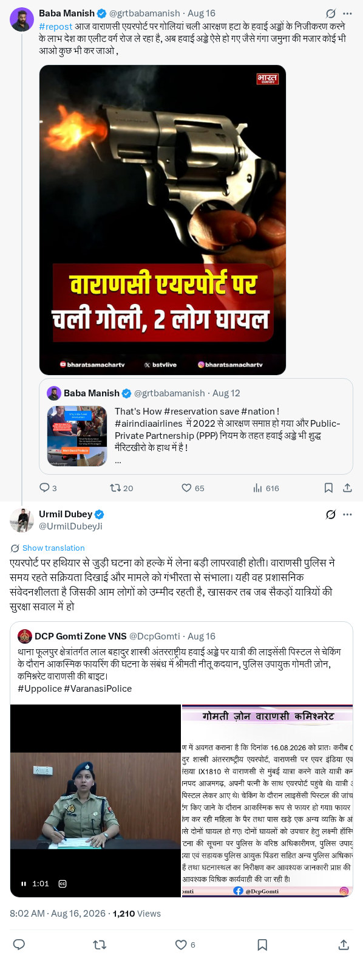
Top 26 Posts
Post 18
@UrmilDubeyJi
20-08-2026
26 Posts
LINK

Slide 43
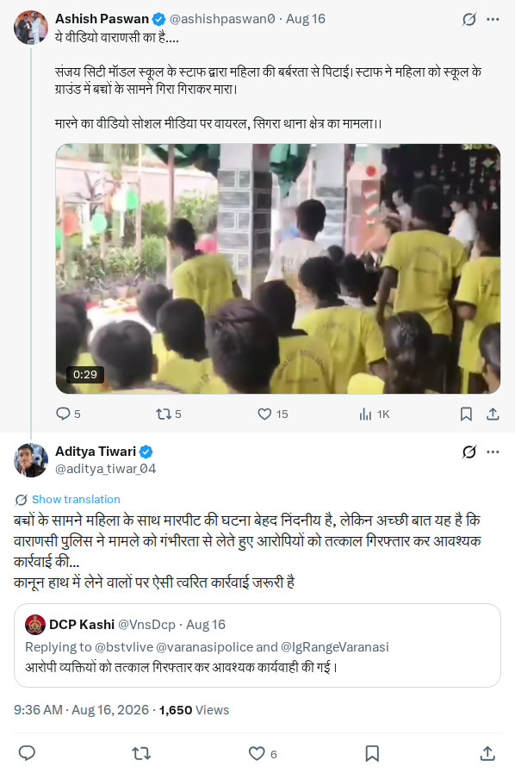
Top 26 Posts
Post 19
@aditya_tiwar_04
20-08-2026
26 Posts
LINK

Slide 44
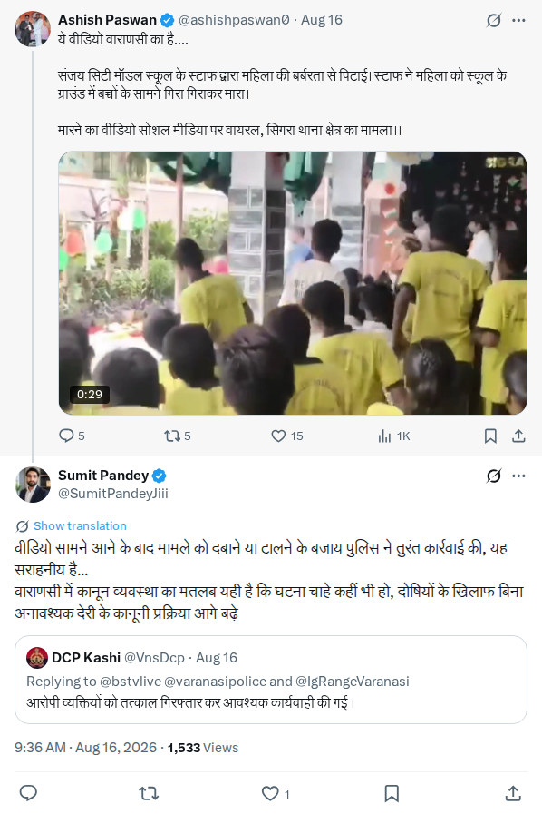
Top 26 Posts
Post 20
@SumitPandeyJiii
20-08-2026
26 Posts
LINK

Slide 45
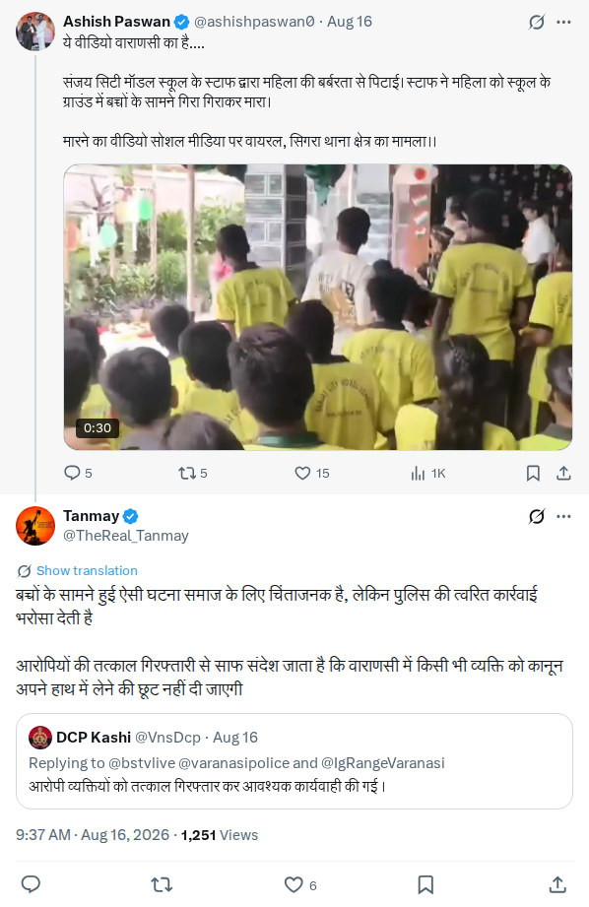
Top 26 Posts
Post 21
@TheReal_Tanmay
20-08-2026
26 Posts
LINK

Slide 46
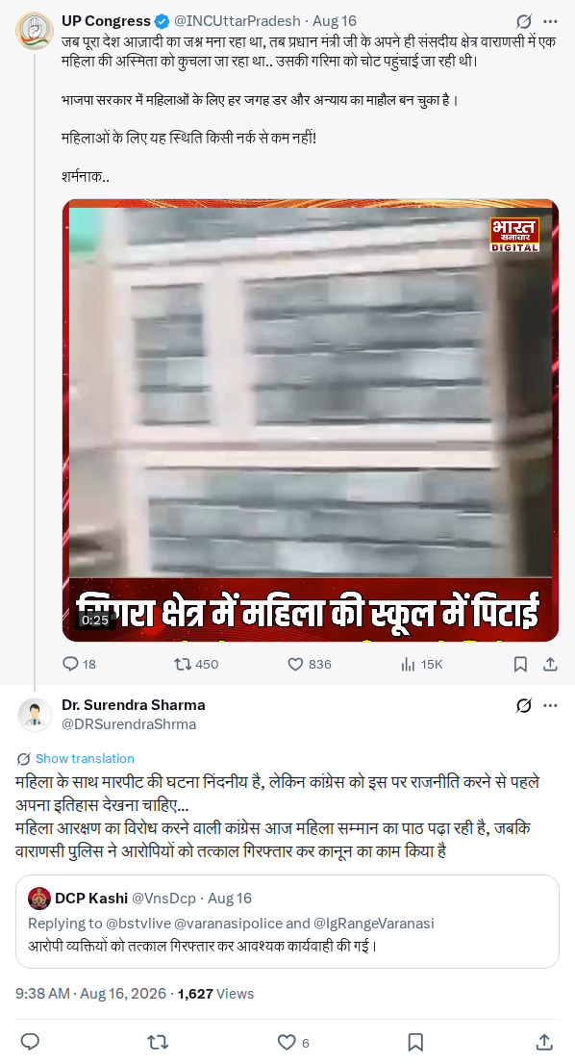
Top 26 Posts
Post 22
@DRSurendraShrma
20-08-2026
26 Posts
LINK

Slide 47
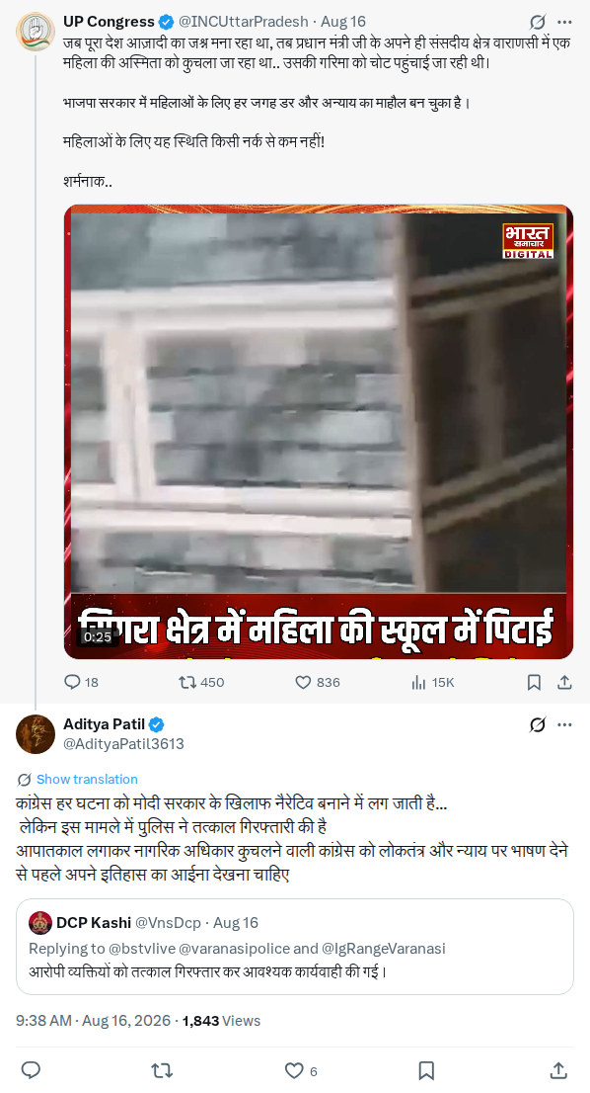
Top 26 Posts
Post 23
@AdityaPatil3613
20-08-2026
26 Posts
LINK

Slide 48
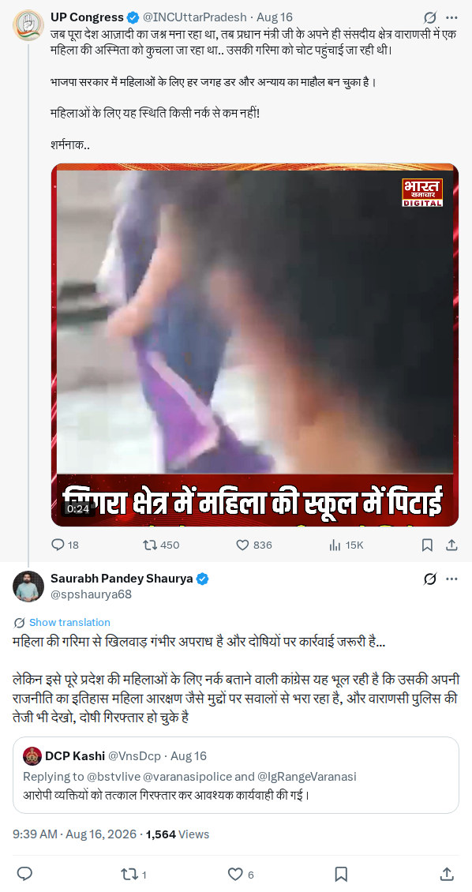
Top 26 Posts
Post 24
@spshaurya68
20-08-2026
26 Posts
LINK

Slide 49

Top 26 Posts
Post 25
@PoonammJi
20-08-2026
26 Posts
LINK

Slide 50
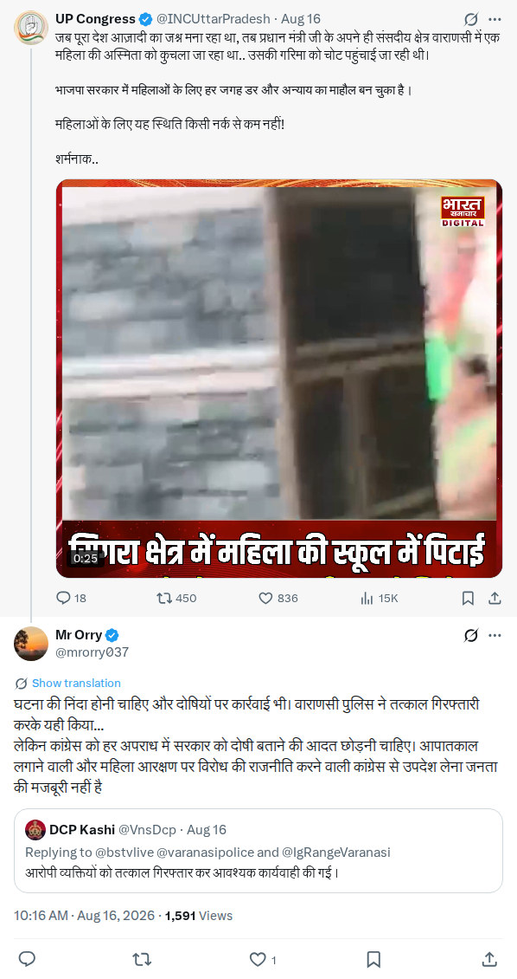
Top 26 Posts
Post 26
@mrorry037
20-08-2026
26 Posts
LINK

Slide 51


